Slide 1
STA/BST 222 Survival Analysis Lecture 6
Lihong Qi
Division of Biostatistics
Department of Public Health Sciences
School of Medicine
Oct. 20, 2020

Slide 2
How to contact me
Email is best: lhqi@ucdavis.edu
Phone: 530-754-9234
Office hour: email for an appointment

Slide 3
How to contact TA
Xiner Zhou
Email: xezhou@ucdavis.edu
Office hours: 7:00pm – 8:00pm, Thursdays
Lab: 6:10-7:00 pm, Thursdays
For both Lab and OH, please use the zoom link with passcode: survival https://ucdstats.zoom.us/j/9681353237?pwd=ZzhLRHlhNG92bHFUaHkwM0Fib1pqQT09 Meeting ID: 968 135 3237

Slide 4
Focus
Likelihood review
Life table
What
Why
How

Slide 5
Likelihood Construction
A refresher: probability vs likelihood
Probability defines a distribution and sum up to one. Probability of a variable given parameter(s) p(x | θ)
Likelihood is not a probability, and it does not define a probability distribution. Likelihood of parameter(s) given the specific data observed,
L(θ | x).

Slide 6
Likelihood Construction
Step 1. identify the types of observations in the data
Step 2. write down the likelihood for each type
Step 3. assume independent observations, and independent censoring, write down the likelihood as the product of likelihood of all observations

Slide 7
Observations
Exact failure (event) time observed: T
Right censoring: T > C, observe X= min(T,C)
Left censoring: T < C, observe X = max(T,C)
Interval censoring: T in (L, R], L for left endpoint and R for right endpoint of the censoring interval
When L = 0, left censoring
When R is infinite, right censoring
f(t), S(t), h(t), H(t) are pdf, survival, hazard and cumulative hazard functions of T, respectively.

Slide 8
Observations
Truncation: T is outside a certain observational window (T_L, T_R)
We only observe subjects whose T fall in the observation window (T_L, T_R)
Left truncation (when T_R is infinite): T < T_L, T_L for left truncation time.
we only observe those individuals whose event time T exceeds the truncation time T_L, ie. T > T_L.
Right truncation (T_L=0): T > T_R, T_R for right truncation time.
we only observe those individuals whose event time T <= T_R.

Slide 9
Noniformative censoring

Slide 10
Examples: censoring
Censoring clearly informative: Suppose that T denotes time to death in a study and that subjects have an increased risk of ’dropping out’ of the study, yielding a censored observation of survival time if their disease status worsens.
In the extreme case, subjects might drop out very soon prior to dying. a statistical method that assumes noninformative censoring might be severely biased and underestimate the true underlying hazard.
Censoring often noninformative: Suppose that survival time is censored because a subject in a study has not yet failed by the pre-scheduled date for the analysis of the study data.
Less clear situation: Suppose the survival times of subjects are censored if they move out of the study area and thereby can no longer be followed for survival. Can you envision speciﬁc circumstances when such censoring is and is not informative?

Slide 11
Observations
Recall: f(t), S(t), h(t), H(t) are pdf, survival, hazard and cumulative hazard functions of T, respectively.

Slide 12
Likelihood Construction
Observation with exact event time observed: provides information on the probability that the event’s occurring at this time, approximately equal to the density function of T at this time, f(t)
Right censored observations: the event time is larger than this time, so the information is the survival function evaluated at the on study time, Pr(T>c) = S(c)
Left censored observations: the event has already occurred, so the contribution to the likelihood is the cumulative distribution function evaluated at the on study time, Pr(T<c) = 1-S(c)
Interval censored observations: the event occurred within the interval, so the information is the probability that the event time is in this interval, Pr(L<T<R) = S(L)-S(R)

Slide 13
Likelihood Construction
For truncated data these probabilities are replaced by the appropriate conditional probabilities
Left truncated observations: q(t|T>=t_L) = f(t)/S(t_{L})
Need to consider conditional distribution of T given T >= t_L
Right truncated observations:
q(t|T<=t_R) = f(t)/ [1-S(t_{R})]
Need to consider conditional distribution of T given T <= t_R
Interval truncated observations: f(t)/ [S(t_{L}) - S(t_{R})]
Need to consider conditional distribution of T given T is within the time interval

Slide 14
Likelihood Construction
Likelihood without truncation and with common censoring times
(1)
D is the set of event times, R the set of right-censored observations, L the set of left-censored observations, and I the set of interval censored observations.
When each individual has a different failure distribution, then replace f and S using f_i and S_i in Eq. (1).
When individuals have different censoring times (random censoring time), then replace , with c_i, the individual censoring time.

Slide 15
Likelihood Construction: type I censoring
Type I censoring
Steps 1 & 2
Censored observation with right censoring time C_r:
Failure:
Combined to a single expression for any observation:
Step 3. Likelihood of all observations:

Slide 16
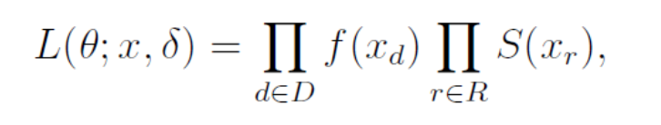
Likelihood Construction : type I censoring
Alternatively expression:
where D is the set of event times, R the set of censored observations.

Slide 17
Likelihood Construction: Random censoring
Random censoring data:
=
using independent censoring, ie., independent between T and C, and let g(t) denote the pdf of C

Slide 18
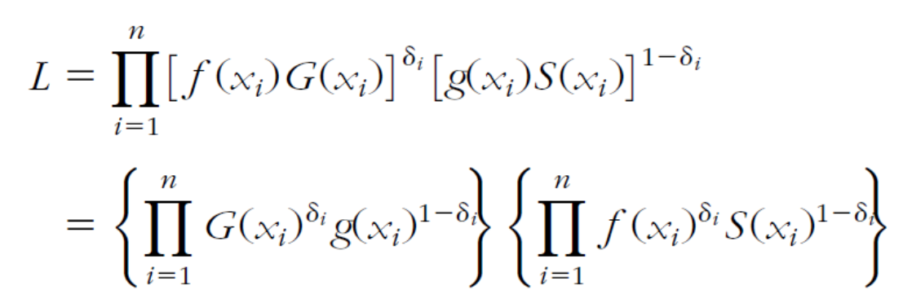
Likelihood Construction: Random censoring
Similarly for failures:
Where G(x) is 1 – CDF of the censoring time C_r
Likelihood for all observations:
Since censoring is noninformaive, the first term can be regarded as constant

Slide 19
Likelihood Construction: random censoring
Alternative expression using hazard and cumulative hazard functions
Using relationship between h(t), f(t), H(t) and S(t),
h(t)=f(t)/S(t) => f(t) = h(t)S(t)
H(t)=-ln[S(t)] => S(t) = exp[-H(t)]
h(t)=dH(t)/dt
We can get

Slide 20
Life table

Slide 21
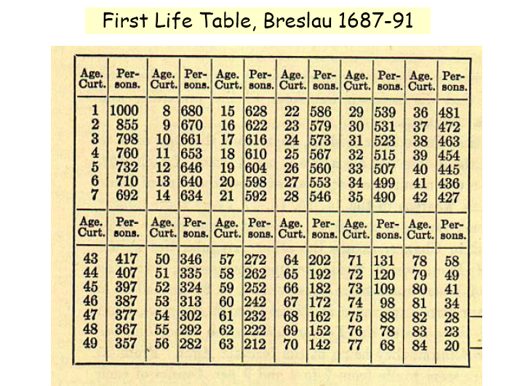
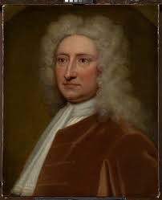
Ref: David R. Bellhouse. A new look at Halley’s life table. J. R. Statist. Soc. A (2011) 174, Part 3, pp. 823–832
In 1693 Edmond Halley constructed a life table or more correctly, as noted by Greenwood (1941, 1943), a population table. It was based on data collected for the years 1687–1691 from the city of Breslau, which is now called Wrocław, by the Protestant pastor of the town, Caspar Neumann.
The table shows the number of lives at various ages, specified as ‘Age Curt.’ or ‘age current’. The appellation ‘1 age current’, for example, means that the individual is in his first year of life so the first birthday has yet to be reached. Ages 1–84 years appear along with the number alive at each of those ages, all arranged in groups of 7.

Slide 22
Life table
In actuarial science and demography, a life table (also called a mortality table or actuarial table) is a table which shows, for each age, what the probability is that a person of that age will die before their next birthday ("probability of death"). (Wiki)

Slide 23
Life tables
For use with a cohort of data
Often following from the birth of the first member to the death of the last
Reasonable way to list any survival data

Slide 24
Life table analysis
Life table:
A life table presents the proportion surviving, the cumulative hazard function, and the hazard rates of a large group of subjects followed over time.
The analysis accounts for subjects who die (fail) as well as subjects who are censored (withdrawn).
The life-table method competes with the Kaplan-Meier product-limit method as a technique for survival analysis.
The life-table method was developed first, but the Kaplan-Meier method has been shown to be superior and with the advent of computers is now the method of choice.
https://ncss-wpengine.netdna-ssl.com/wp-content/themes/ncss/pdf/Procedures/NCSS/Life-Table_Analysis.pdf

Slide 25
Rewrite survival function
S(t)=P(T>t) =P(T>t1)*P(T>t|T>t1) =P(T>t1)*P(T>t2|T>t1)*P(T>t|T>t2) =…… where t1<t2<t.
The above expression is useful for survival data with censored observations.

Slide 26
An example
19 rats exposed to carcinogen, days to death reported as: 143, 164,188, 188, 190, 192, 206, 209, 213, 216, 216*, 220, 227, 230, 234, 244*, 246, 265, and 304 days. (Pike 1966)
* censored

Slide 27
Life Table for rat example Assume no censored observations.
Pr(T>t1) = 18/19 = 0.9474
Pr(T>t2|T>t1) = 17/18 = 0.9444
Pr(T>t3|T>t2) = 11/17 = 0.6471

Slide 28
Life Table for rat example
S(T>t2) = Pr(T>t2|T>t1)* Pr(T>t1)
= 17/18*18/19 = 17/19 = 0.8947

Slide 29
Life Table for rat example
S(T>t3) = Pr(T>t3|T>t2)* Pr(T>t2)= Pr(T>t3|T>t2)* Pr(T>t2|T>t1)*Pr(T>t1)=
= 11/17 * 17/18 * 18/19 = 11/19 = 0.5789

Slide 30
A very practical problem
Not all subjects will die during follow up!!
Drop outs for whatever reason
Die from other causes than that under study (vaginal cancer in rat study)
Survive to the end of the study
Collectively known as censored data

Slide 31
How do we deal with this in the Life Table?

Slide 32
Some useful terms
Assume D distinct times, i.e. t₁<t₂<…<t_{D}
Number of subjects at risk: subjects were alive at the beginning of the interval
Notation: Y_{j}, j=1,…D
Number of subjects who died in the interval (deaths)
Notation: d_{j}, j=1,…D
Number of subjects who withdrew (censored) in the interval (loss)
Notation: m_{j}, j=1,…D

Slide 33
Adjust the number of subjects at risk
In constructing actuarial life tables, the following assumptions are often made:
First, the events of interest (e.g., deaths) are assumed to occur at the end of the interval and censored events are assumed to occur uniformly (or evenly) throughout the interval.
Y_{j} = Y_{j} - m_{j}/2: the average number of participants at risk during interval t (i.e., we subtract half of the censored events).

Slide 34
Adjusted numbers at risk

Slide 35
In the life table
proportion surviving (remaining event free) interval t, p_{t} = 1- d_{j} /Y_{j}
the proportion surviving (or remaining event free) past interval t; this is sometimes called the cumulative survival probability and it is computed as follows:
First, the proportion of participants surviving past time 0 (the starting time) is defined as S₀ = 1 (all participants alive or event free at time zero or study start).
The proportion surviving past each subsequent interval is computed using principles of conditional probability. Specifically, the probability that a participant survives past interval 1 is S₁ = p₁.
The probability that a participant survives past interval 2 means that they had to survive past interval 1 and through interval 2: S₂ = P(survive past interval 2) = P(survive through interval 2)*P(survive past interval 1), or S₂ = p₂*S₁. In general, S_{t+1} = p_{t+1}*S_{t}.

Slide 36
Mathematical formula in life tables
Survival (survivor function) S_{j}
where y_{j} = Y_{j} - m_{j}/2 is the adjusted number at risk
standard error (Greenwood’s formula)

Slide 37
Homework 2
Reading: KM 3.5
Understand life table
Other: as assigned before

